Slide 1



Meeting Veterans Where They Are:
Their Smartphones
May 15, 2020
Jeremiah Hay, A. Taylor Thomas, Lien Tran

Slide 2
IN THIS PRESENTATION
01
02
03
04
BACKGROUND
USER RESEARCH
PROTOTYPING
Conclusion

Slide 3
BACKGROUND
01

Slide 4
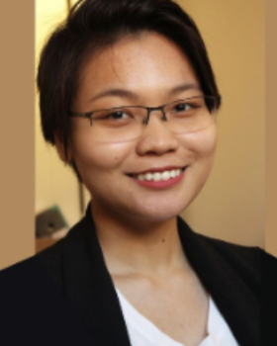

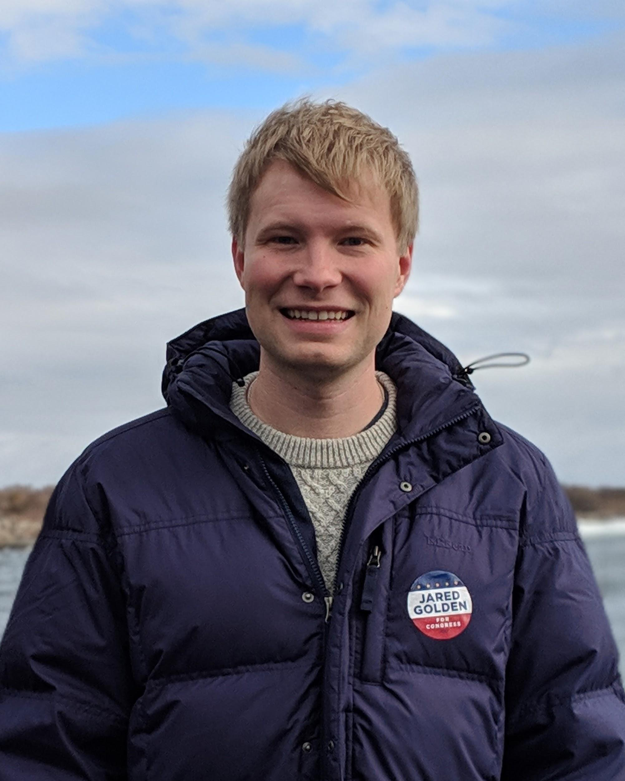
Our Team
Lien Tran
A.Taylor Thomas
Jeremiah Hay
Student at Harvard College
MD/MPH student at Harvard T.H. Chan School of Public Health
Student at Harvard Kennedy School

Slide 5



Our Client
Charles Worthington
C.C. Gong
Clarice Chan
U.S. Department of Veterans Affairs CTO
Presidential Innovation Fellow
Presidential Innovation Fellow

Slide 6
BACKGROUND
> 20 million
U.S. VETERANS
More than 9 million receive benefits ranging from healthcare to professional development to home loans.

Slide 7
BACKGROUND
Innovation
AT THE VA
Invented the nicotine patch and implantable cardiac pacemaker
Pioneered Electronic Medical Records
In 2018, revamped VA.gov to provide a more user-centric experience

Slide 8
THEIR VISION
“VA will deliver self-service tools on par with top private sector companies, and will have the best online experience in the federal government. Every digital service will be personalized to the individual using it.”

Slide 9
OUR MISSION
To explore how we can make it easier for Veterans to access their online services and benefits, particularly in light of the increase in mobile users on VA.gov

Slide 10
In other words, how to turn the Veteran who said this:
“ [I expect] A super clunky implementation of a lumbering government agency.” - Alex T., Air Force Into the Veteran who said this:
“This is self-explanatory and intuitive...Something like this would be very helpful...Actually, I would use this.” - Alex T., Air Force, after 10 minutes with our app prototype

Slide 11
USER RESEARCH
02

Slide 12
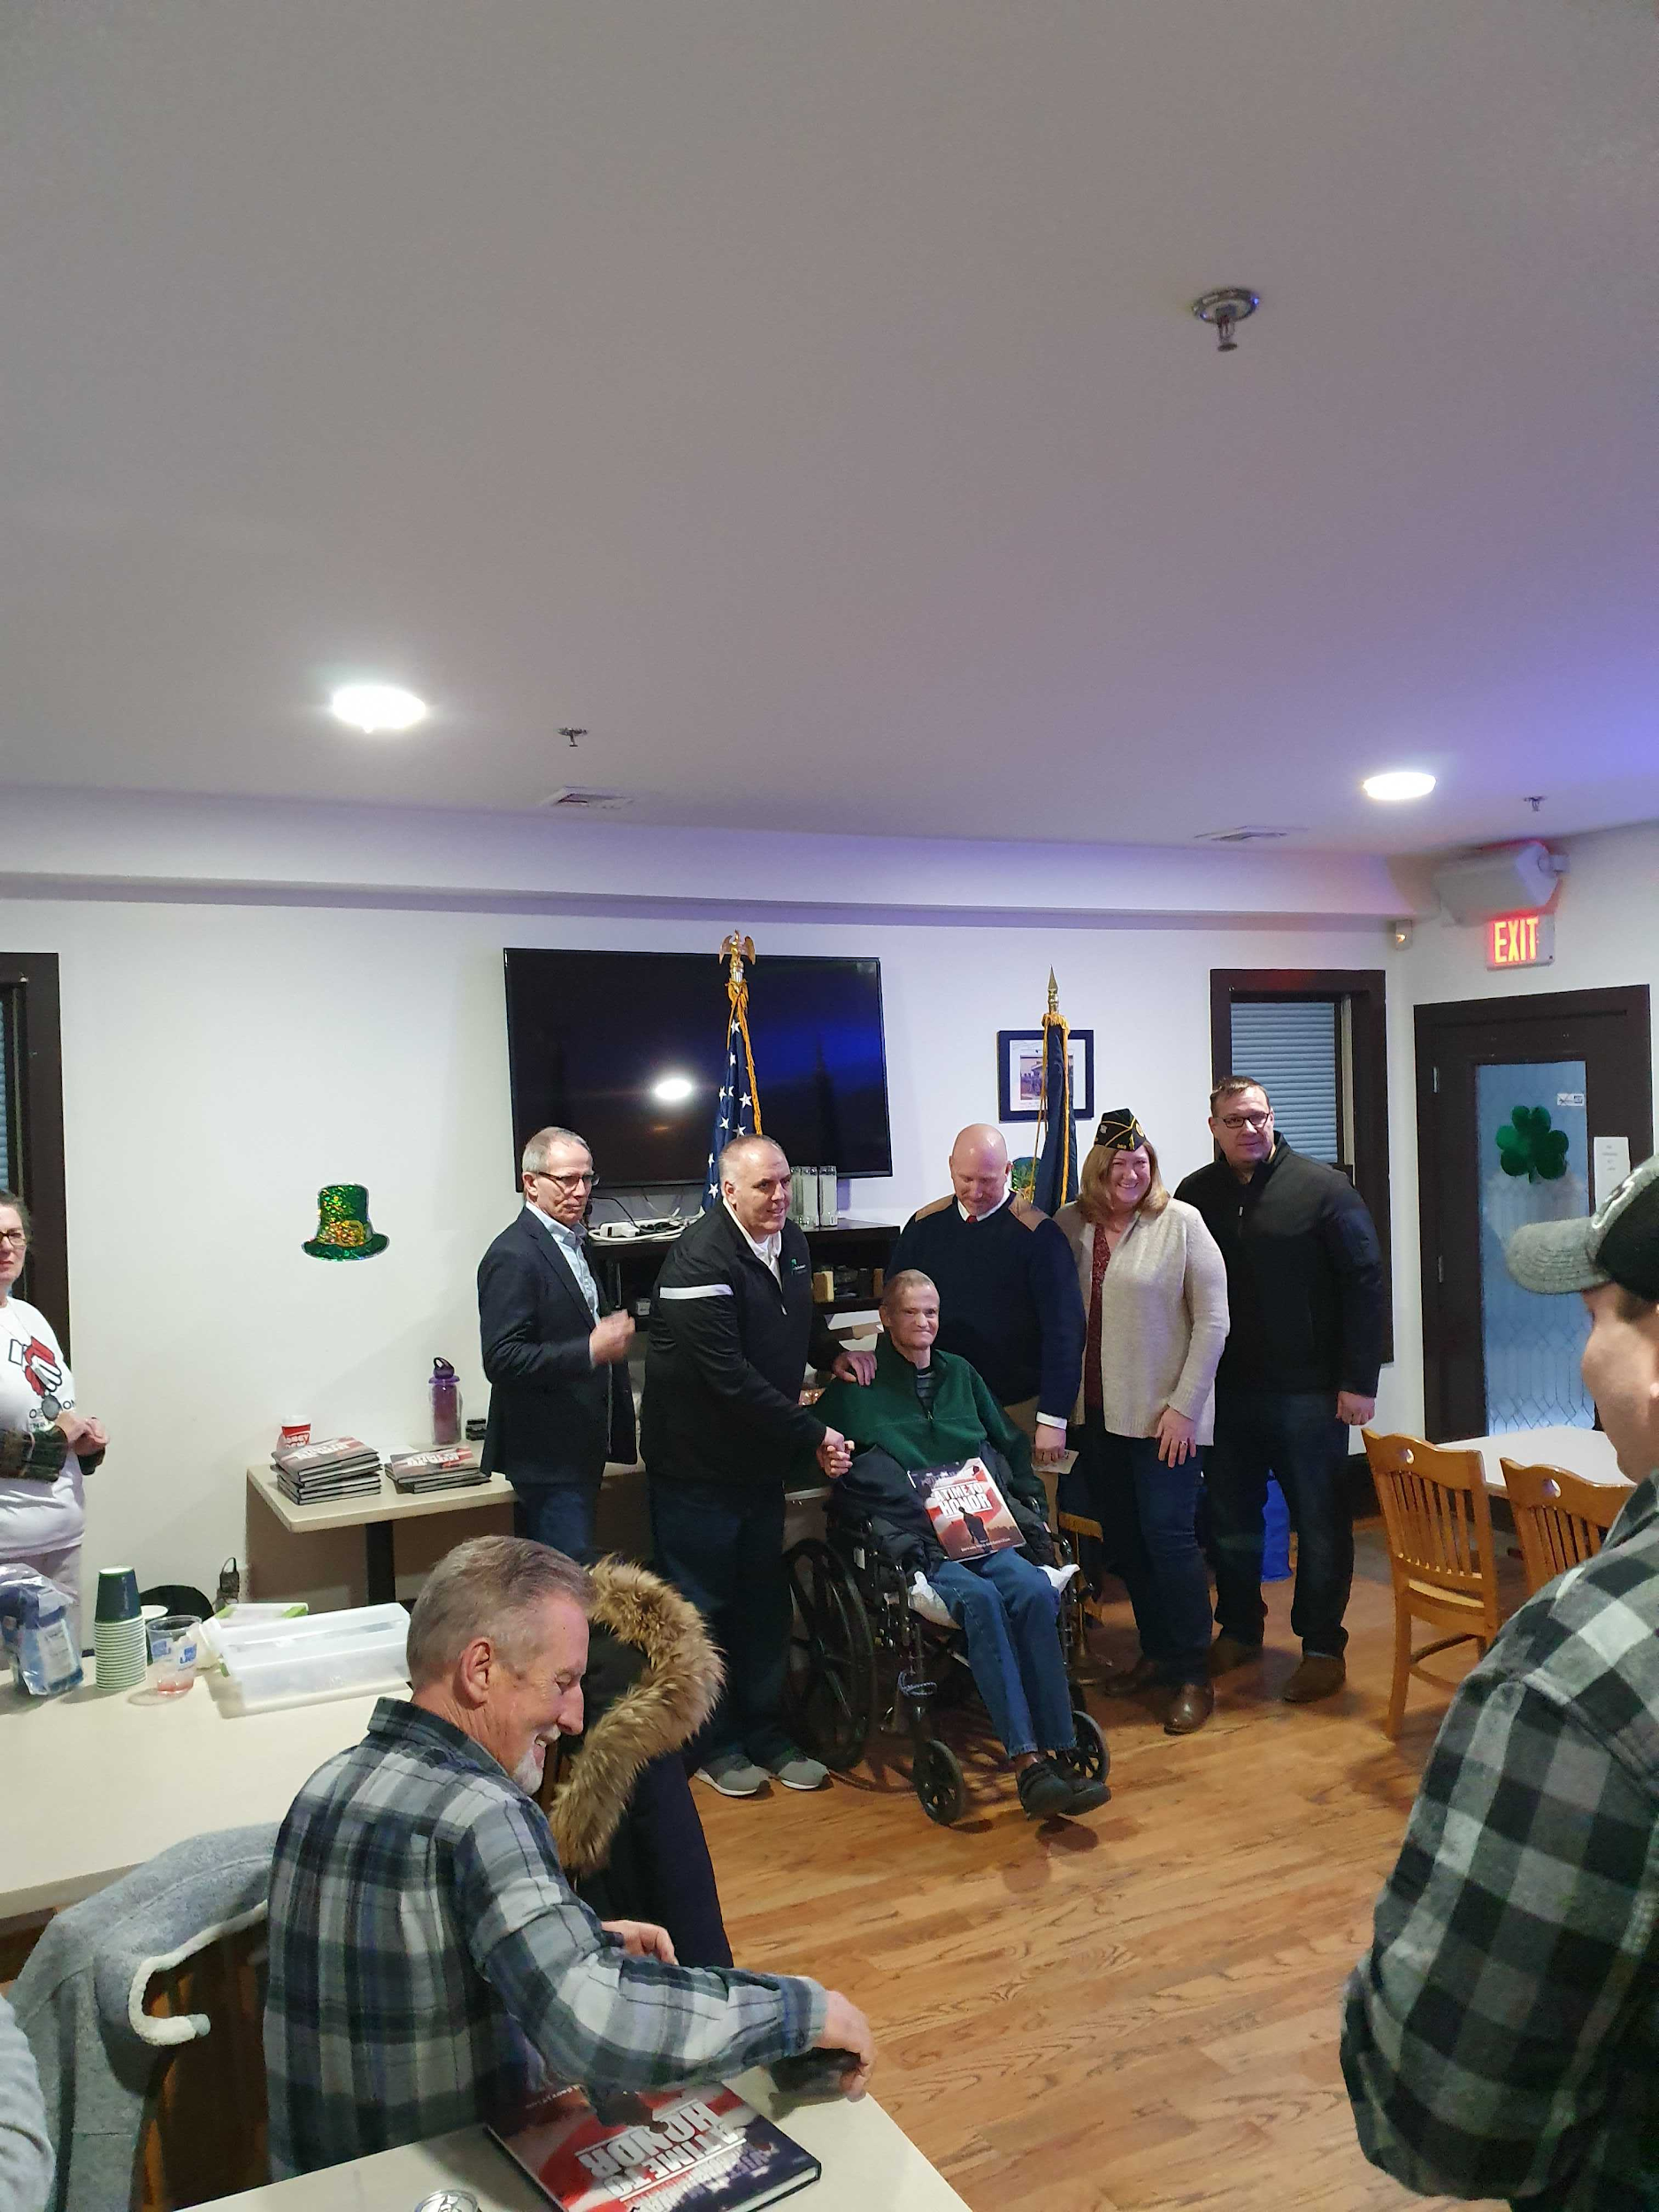
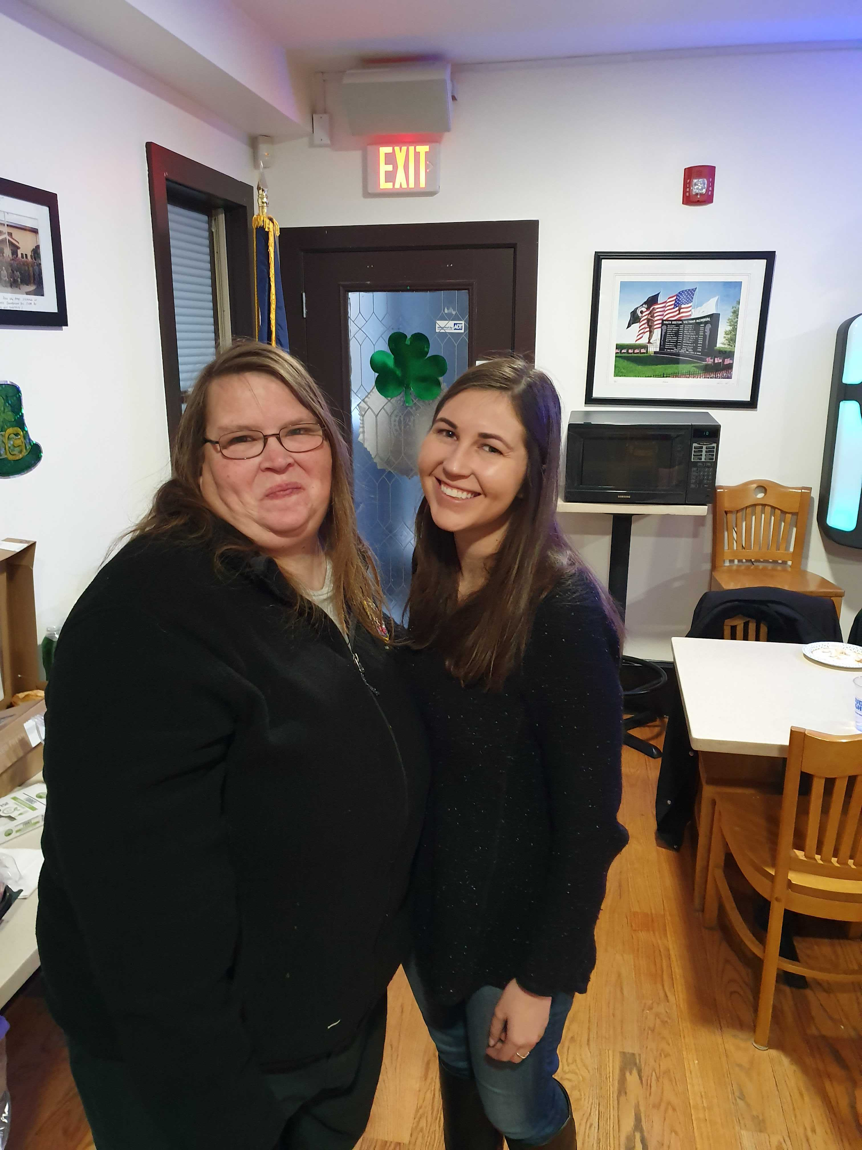



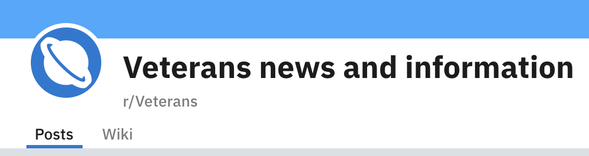
REACHING OUT TO VETERANS

Slide 13
64 User Research Interactions
35 in-person interviews
29 Veterans who filled out an online survey
38 Prototype Feedback Sessions
13 Veterans who did a one-on-one prototype feedback session
25 Veterans and VA beneficiaries who recorded self-guided prototype feedback sessions
We had 102 in-depth interactions

Slide 14
INSIGHTS
PAIN POINTS OF POTENTIAL USERS
FRAGMENTED EXPERIENCE
TROUBLE FINDING ANSWERS
ELIGIBILITY UNCERTAINTY
“I'll probably forget the password and then get it emailed to me. And then things are just scattered.” “ When I applied I used my DC address, but when I moved to Boston… It got lost because ‘Now he’s in the Boston system, not the DC system,’ and I had to apply again.”
“A lot of clicks.”
“There was a lot of searching...you had to know where you were”
“I’ve about blown a gasket just trying to get the right person on the phone.”
“There is most probably more out there that I am eligible for that I am not taking advantage of.”
“Determining… what you are eligible for should be easier. Everyone wants to know and it is kind of hard to determine”

Slide 15
POTENTIAL GAINS
MANAGING APPOINTMENTS
COMMUNICATING WITH DOCTORS
ELIGIBILITY DETERMINATIONS
QUICK ACCESS TO DOCUMENTS
“Appointment reminders/being able to schedule appointments” was the most requested functionality
87% of survey respondents agreed.
Even older, less tech-literate Veterans reported a desire to communicate directly with their medical team online.
69% of survey respondents agreed.
Many Veterans requested a function that “can look at my situation and provide me a list of all available programs and services.”
72% of survey respondents agreed
Many current users of the mobile site were driven by a need to get documents and information on the go.
83% of survey respondents agreed.

Slide 16
Mobile Solution Considerations
Aspect | Responsive Website | Progressive Web App | Native App
Brief Description | Make changes to the website’s layout if mobile screen is detected | A “hybrid” between a web app and a native app | An app built for intended specific platforms (e.g. iOS/ Android smartphones)
Access to Features | Through common web browser | Via URL and/ or icon on phone’s home screen Crawlable and discoverable by search engines | Download via App Store, Play Store and access via home screen
Flexibility of Feature Development | Limited. Content is strictly dependent on the original | Somewhat limited (e.g. can’t use camera, send push notifications on iOS) | Only restricted by platform. Full-fledged features of a typical mobile app
Development Cost | Low | Medium | High
Meets Most Requested Features | No | No | Yes

Slide 17
PROTOTYPING
03

Slide 18
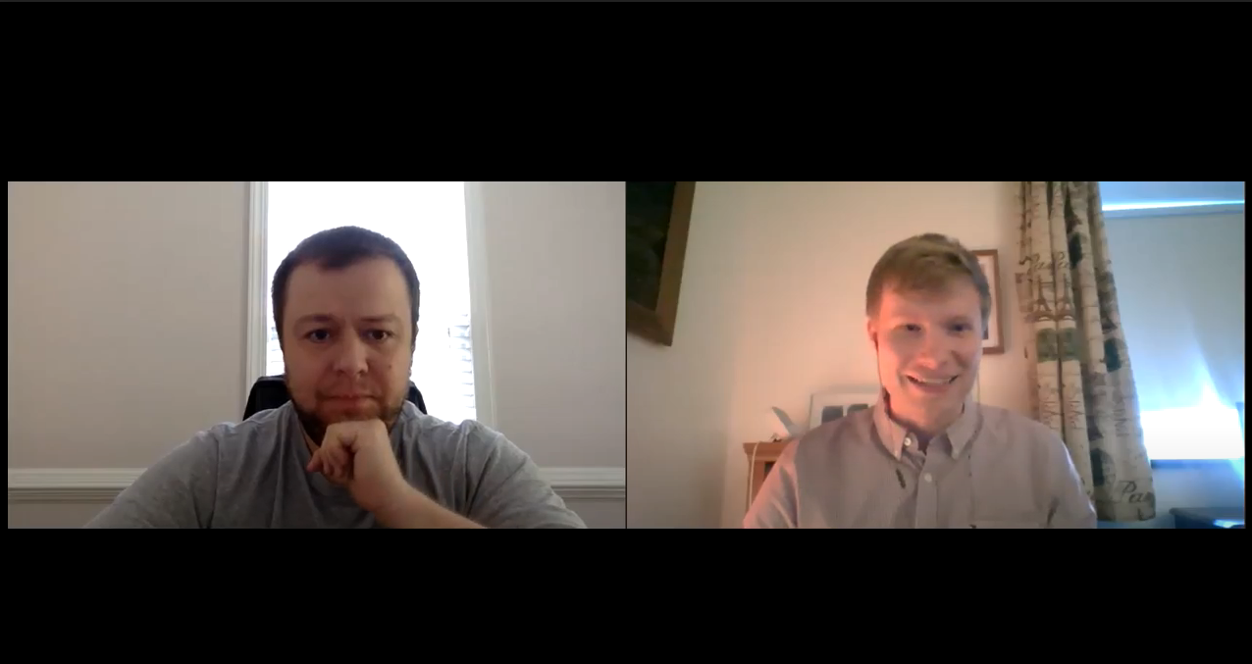

Remote Feedback Sessions
A remote chat with “Smith”, a 34-year-old veteran from North Carolina...

Slide 19
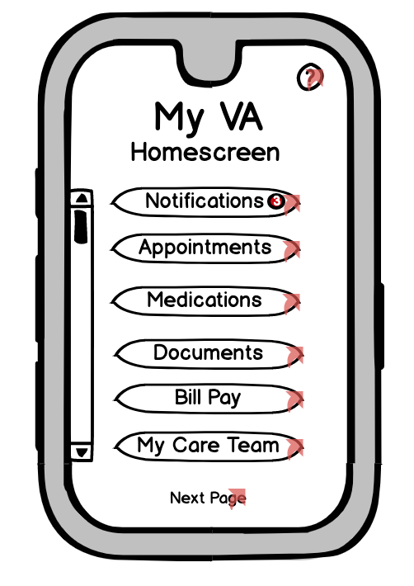
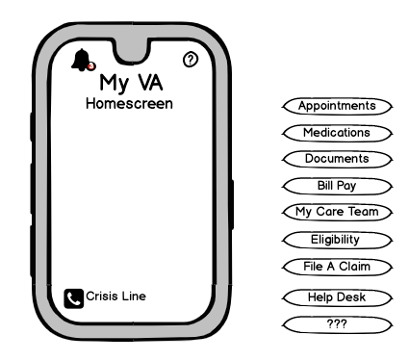
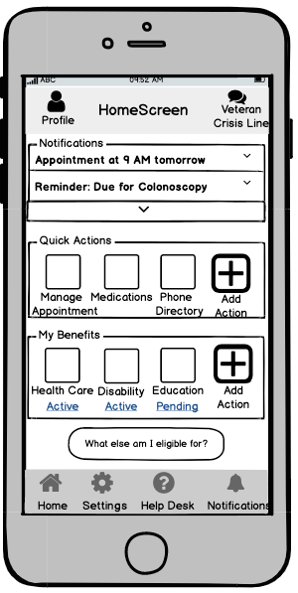
Our Prototypes: Evolution of the home screen
Prototype 1.0
Prototype 2.0
Prototype 5.0

Slide 20
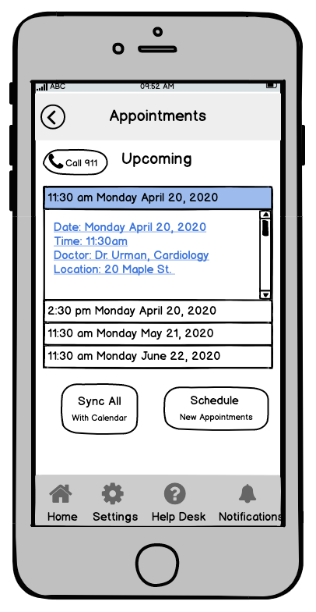
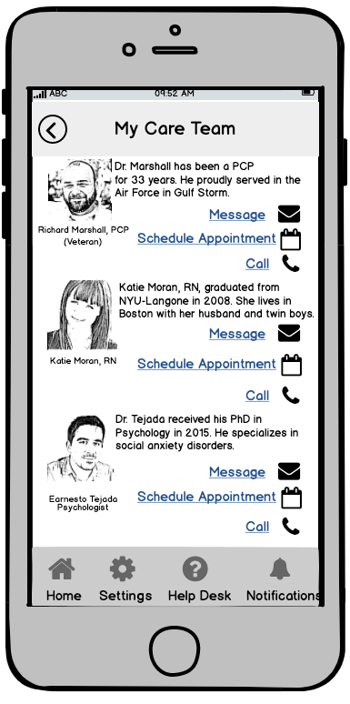
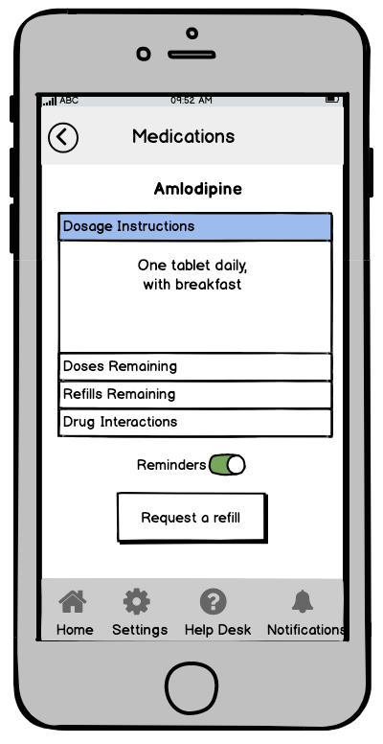
Features for Health Care
Make medical appointments
Communicate with their medical team
Manage their medications

Slide 21
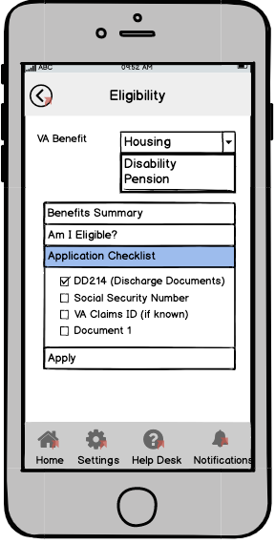
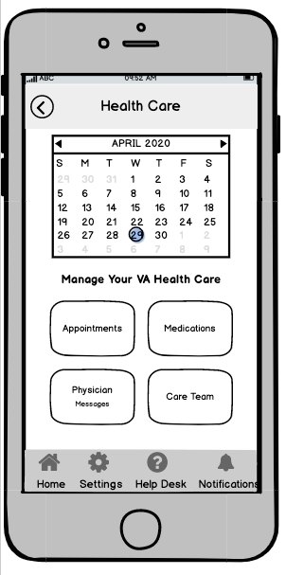
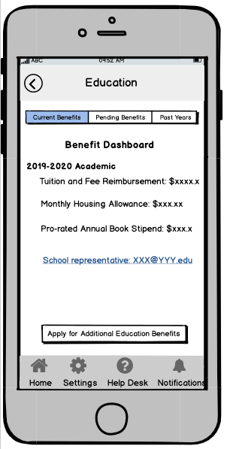
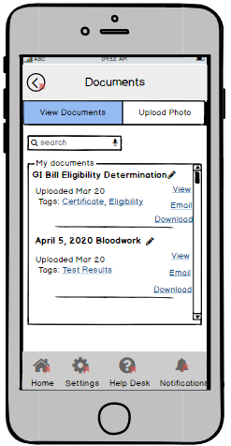
Streamlined Information Access
Determine their Eligibility
Review & Manage their Benefits
Access & Upload Paperwork

Slide 22
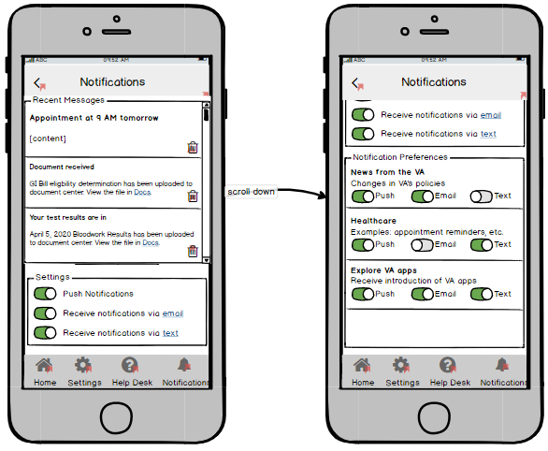
Customize and Control Communication
Setup one-tap Quick Actions
Set up notifications and reminders

Slide 23
Determine Eligibility
“For eligibility, I would probably use the app [instead of the website]- everything’s right there in one place.”
“I’m expecting that the website is going to have more information [...] I would assume that the app is a condensed version, whereas the website has everything that I need to know.”

Slide 24

Make Appointments
“Straightforward, self-explanatory… It was very easy. I didn’t even have to think about it, it was automatic.”
“I would say that was very easy.”

Slide 25
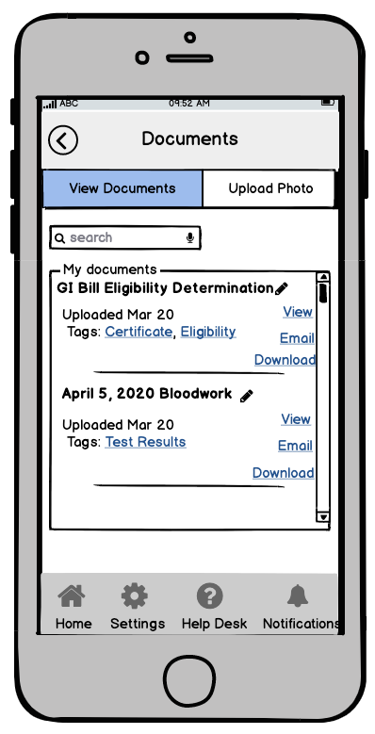
Manage Paperwork
“This is all really important. I think it is hard to explain unless you have had to deal with it. There’s a lot of times that I need this stuff and it’s not easy to get.”
“It’s good to be able to tag something as relevant to you ...so when you have to resubmit because the VA has denied the claim you don't have to go through a box of papers.”

Slide 26
CONCLUSION
04

Slide 27
Our Recommendation: A Streamlined Multifunctional App
A mobile app solution offers unique advantages
Streamlined
Simple to navigate
Easy to use “on the go”
Provides new functionality
Personalized
But: “Don’t make an app just for its own sake. Make sure it is reliable…”
Don’t add to fragmentation
Make the learning curve as gentle as possible
Make it comprehensive

Slide 28
Conclusion
Our user research confirmed that there is no “typical user,” and that Veterans’ needs and preferences are hugely varied. Still, we heard some common refrains with surprising frequency:
Finding the right person at the VA can be complicated and time-consuming
Navigation through existing channels is often confusing
Vets would use an app - if it did what they wanted it to, and was easy to understand.

Slide 29
Recommendations
Almost all of the Veterans we talked to had challenges with the VA stemming from fragmented administration. These included:
Having a hard time finding the right information
Constantly filling out the same paperwork
Not knowing what benefits exist or which ones they were eligible for

Slide 30
Recommendations (cont’d)
A VA app is one part of a broader effort to meet Veterans where they are. Increased data sharing across silos would alleviate many of these challenges and allow the VA to learn a lot more about Veterans.
This knowledge could enable the VA to do more targeted, proactive, and efficient service delivery.
It would also allow the VA, and Veterans, to leverage the unique strengths of a native mobile app.

Slide 31
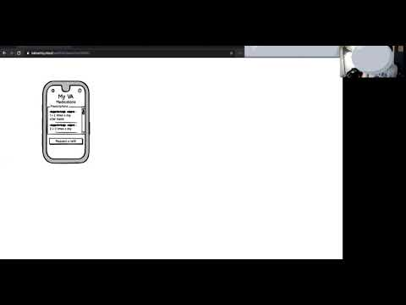

Slide 32
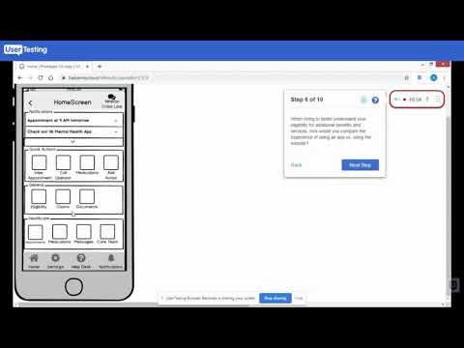

Slide 33
Parting Notes
Our research will have been successful if:
It encourages conversations with Veterans as a routine part of policymaking and implementation.
The VA can use our findings, insights, and suggestions to catalyze technological progress, building upon existing efforts.

Slide 34
THANK YOU
VA Digital Team: C.C. Gong, Clarice Chan and Charles Worthington
Teaching Team: Nick Sinai, David Leftwich, Bobby Wang, Ariana Soto and Miro Bergam

